Slide 1
Azure Functions
Mehdi Khaleghian
Notes:
http://news.genius.com/Marc-andreessen-why-software-is-eating-the-world-annotated

Slide 2
What we are going to cover
Serverless Computing
Serverless Architecture
Players in the market
Azure Serverless offerings
Azure Functions Overview
Hosting plans
Demo
Benefits and Drawbacks

Slide 3
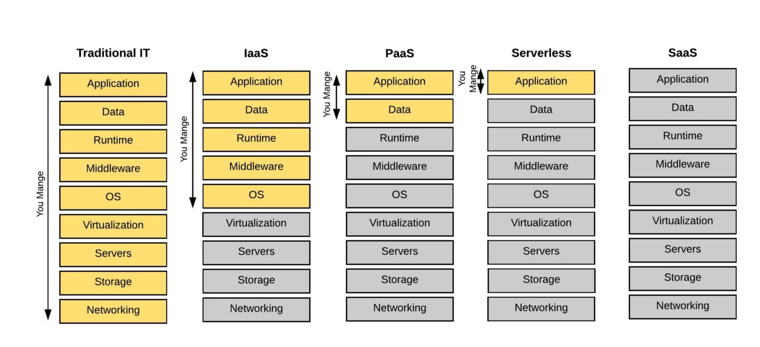
What is serverless?

Slide 4

Serverless is an architecture
For as long as I can remember there’s been a general understanding in the tech community — that the future of computing lies in an internet connected thin-client architecture.
But I think that something else is sneaking up on us, and an alternate future of software architectures is materialising — based on serverless architectures. This future is characterized by rich thick-client applications talking directly to cloud datastores and small cloud-based micro-services for protected workloads & service orchestration.
Sam Kroonenburg
Co-Founder of A Cloud Guru

Slide 5
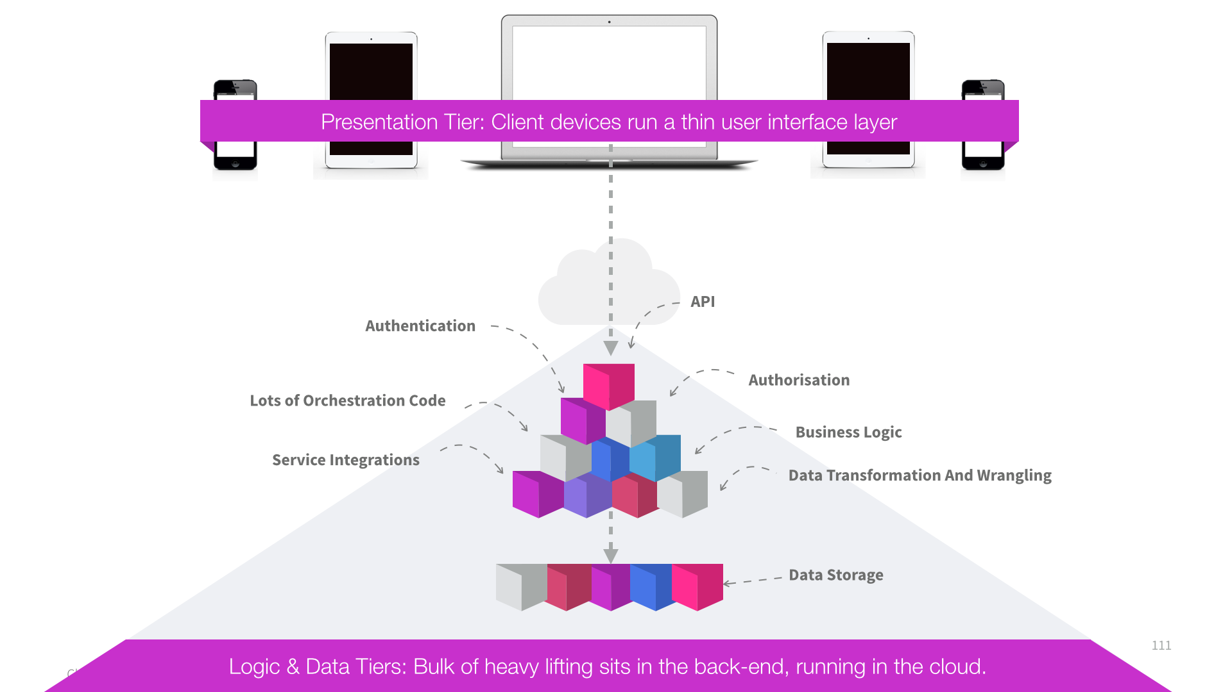
Typical 3-tier architecture
User interface drives function in the backend
Huge Duplication
Need to touch every layer to add new features
Business logic resides on the server-side

Slide 6
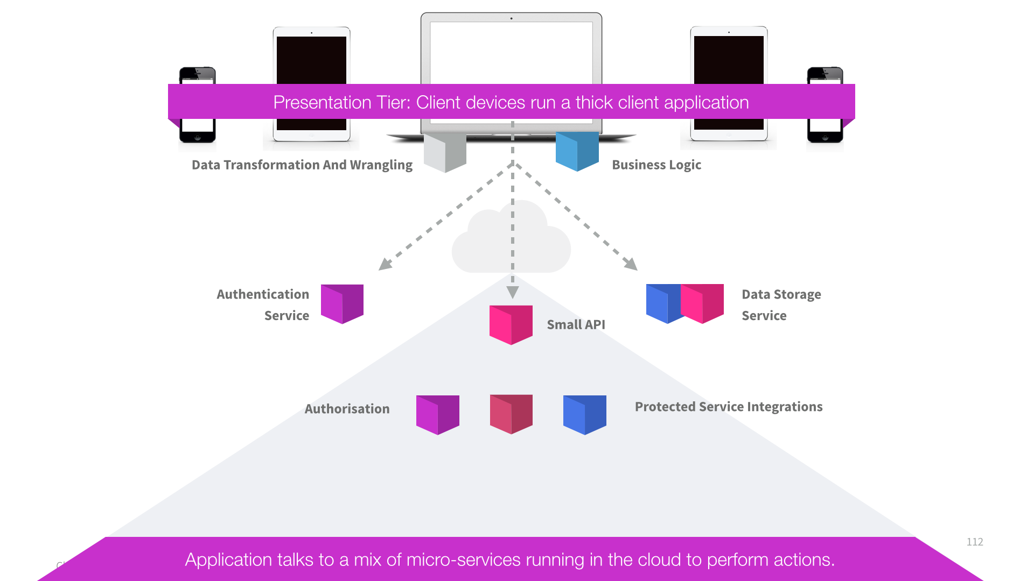
Serverless Architecture
Client devices run a thick client application
UI application contain all of the orchestration logic
UI talk directly to a range of cloud-enabled services
Micro-services perform authentication, storage, notification ect

Slide 7



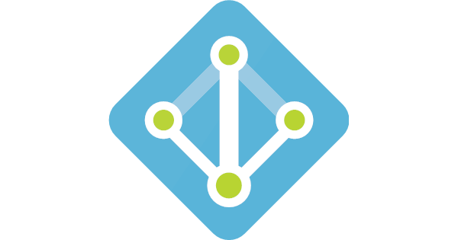
Serverless Architecture
Serverless Architecture Depends as much as possible on third party applications or services running in the cloud
Often client side is implemented as a single-page web application
Third-party database service
FaaS
Web App (SPA)
or Mobile
Third Party Authentication Service
Notes:
It is not possible to fully depend on third party services for your entire application
In recent years another type of application codes started to emerge
This lets you deploy small functions, snippets of code without managing any servers yourself
So serverless great ideas are
Make use of third party services ie database services, authentication services
And write your own code without the need to manage servers

Slide 8
You can even go fully Serverless
Use Azure Blob Storage or CDN for hosting SPA
Use Azure Table instead of Azure SQL
Use Azure Storage Queue or Service Bus Queues
Notes:
Blob Storage limitations: no custom domain on SSL because SSL is not supported
Container name and file name is part of the url
There is no default page
CDN has additional cost of CDN use + blob storage and use

Slide 9
Benefits
No more managing servers
Focus on what really matters
Automatic Scale
Cost-effectiveness
Rapid Prototyping
Avoid using Infrastructure as a Service (IaaS)
Prefer Platform or Function as a Service
Avoid spending time writing Infrastructure Code
Only write the code that is specific to your business domain
Avoid the need to implement scale out yourself
Additional capacity is automatically provisioned for you
Avoid paying monthly fees for under-utilized servers
Pay only for what you use – minimal cost during prototyping
Avoid slow starts and get quickly to proof of concept
Create a low cost prototype you don’t need to throw away
Notes:
https://azure.microsoft.com/en-au/overview/serverless-computing/

Slide 10
Drawbacks
Third Party Service SLAs
Less Control
Latency
Variable Costs
Immature Tooling
Notes:
Services which you rely on can be temporarily down
You don’t have control over the framework that is in use for example
How long does it take for example for a web api hosted in the cloud to ramp up when it has not been used for some hours
You might get nasty surprises because of the high load which is not coming from paying customers
Relatively new, some of the toolings are still in the new stages but because of good support in the community new improvements are coming on the daily basis

Slide 11

Amazon AWS Lamda
JavaScript
Node.js
Python
Java
C# and F# (.Net Core)
Introduced in 2014
Documentation is comprehensive and always up-to-date
Community is quite large
Has a free tier that allows for one million requests and 400 terabyte-seconds of compute time per month

Slide 12

Microsoft Azure Functions
JavaScript
Node.js
Python
C# and F#
PHP
Bash
Batch
PowerShell
Released preview in March 2016
Support languages that help with DevOps (managing machine, instances etc)
The cost is the lowest when traffic is added to the cost compared to other providers

Slide 13



Other players
Google Cloud Functions
IBM OpenWhisk
Fission.io

Slide 14
Azure Serverless offerings
Azure Functions Serverless Computing
Azure Logic Apps Serverless Workflows
Event Grid Serverless event routing
Notes:
These are wording from an old document

Slide 15



Azure Functions
Function as a Service
You simply provide the function
Use your preferred language
C#, JavaScript, F# and many more
Group functions into “Function Apps”
Each function has a trigger
For example:
A convenient way to keep related functions together
Notes:
Function App provide a convenient way to keep related functions together
HttpTrigger is ideal for having the backend for single page application

Slide 16
Azure Functions
Bindings
Integrate with queues, blob storage ect
Automatic Scale
Process queue messages in parallel
Pricing model
No fixed monthly fee
Pay for what you use
Monthly free grant
Notes:
Function App provide a convenient way to keep related functions together
HttpTrigger is ideal for having the backend for single page application

Slide 17
Hosting Plans
App Service Plan
Consumption Plan
Dedicated Service plan
Predictable monthly cost
Pay for what you use
Billing based on
- Number of executions
- CPU time * RAM
Limited 10 minutes execution time
Free monthly grant
Linux Hosting is available
Scaled Automatically
App Service Environment, VNET/VPN Support
Suited when runs continuously
1,000,000 executions
400,000 GB-s
Fewer Invocations
Faster Invocation times
Reduced memory requirements

Slide 18



Demo
Web hook
Azure Queue
Azure Table
Azure Queue
Azure Blob
SendGrid
Azure Blob
Azure Table

